Slide 1



Ministry of Science and Higher Education of the Republic of Kazakhstan
L.N. Gumilyov Eurasian National University
Faculty of Information Technology
Department of Information Systems
Face Filters, Methods of processing and filtering facial images
Done by: Yerassyl Iskakov
CHECKED BY: PROF. ZHUKABAYEVA T.K.

Slide 2
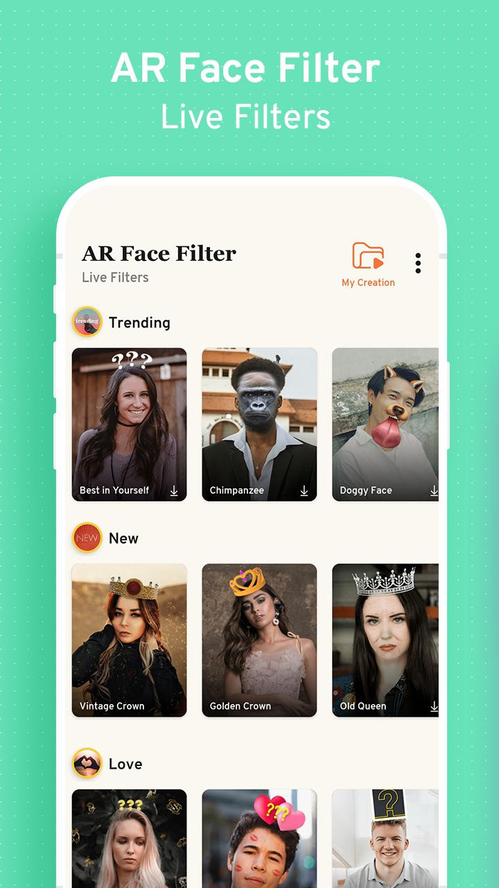




INTRODUCTION
Everyone knows Snapchat filters. Face filters are everywhere now in our apps: Instagram, TikTok, Snapchat… But how does that even work?
Detecting facial key points is a very challenging problem. Facial features vary greatly from one individual to another, and even for a single individual, there is a large amount of variation due to the 3D pose, size, position, viewing angle, and illumination conditions.
Social Media platforms

Slide 3
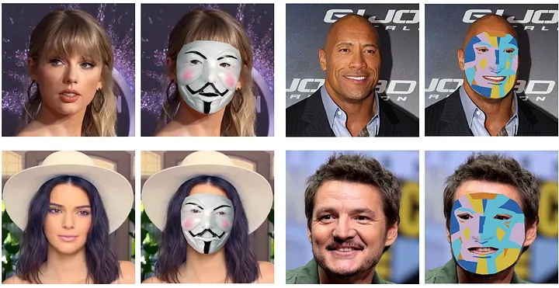
WHAT ARE FACE FILTERS?
Face filters are digital effects that overlay images or animations onto a user’s face in real-time. They can modify facial features, apply makeup, or add humorous or artistic elements to a photo or video.
Originally popularized through social media apps, face filters use AR technology to track facial landmarks and superimpose digital graphics onto live or captured images. These filters range from subtle enhancements, like smoothing skin tones, to elaborate transformations that turn users into cartoon characters or fantastical creatures.
Examples of face filters applied to a few images

Slide 4
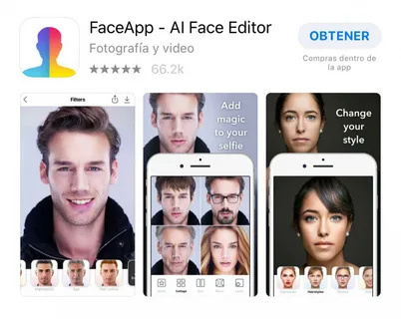
TYPES OF FACE FILTERS
Beautification Filters: These enhance natural facial features by smoothing skin, adjusting lighting, and adding makeup effects.
Transformative Filters: These alter the user’s appearance drastically, turning them into animals, or fictional characters, or adding humorous elements like oversized glasses or hats.
Interactive Filters: Utilizing facial recognition technology, these filters respond to user actions, such as blinking or smiling, to trigger animations or effects, creating a playful and engaging experience.
Artistic Filters: Inspired by art styles or historical periods, these filters apply creative overlays to photos, mimicking the aesthetics of paintings, sketches, or graphic designs.

Slide 5
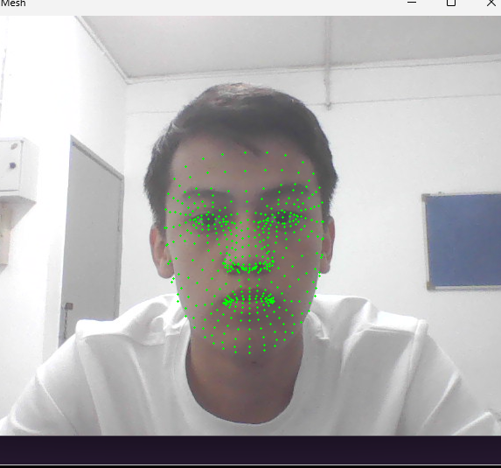
FACIAL RECOGNITION
Facial recognition scanning systems also use computer vision technology to identify individuals for security purposes. The most common example of computer vision in facial recognition is for securing smartphones. More advanced uses of facial recognition and biometrics include residential or business security systems that use unique physiological features of individuals to verify their identity.
Deep learning algorithms can identify the unique patterns in a person’s fingerprints and use them to control access to high-security areas such as high-confidentiality workplaces, such as nuclear powerplants, research labs, and bank vaults.
Face landmarks using Mediapipe

Slide 6
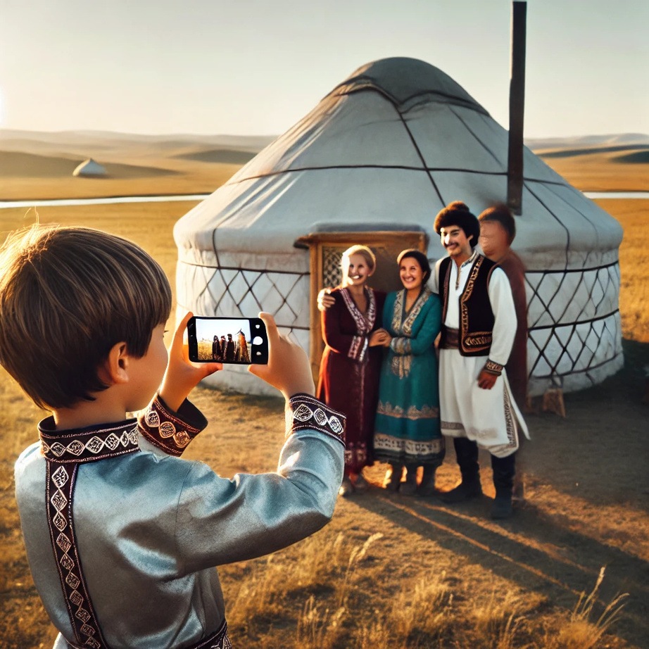
IMPORTANCE
Face filters have gained popularity due to their ability to transform mundane images into engaging and entertaining content. They offer a creative outlet for self-expression, allowing users to experiment with different looks and personas. Social media platforms have amplified this trend by integrating filters into their apps,
We need filters to make photo look aesthetic or even for just entertainment

Slide 7
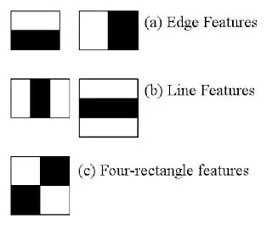
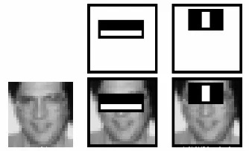
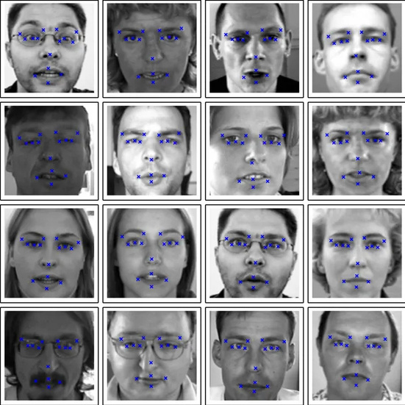
HOW DO FACE FILTERS WORK?
Haar feature-based Facial Feature detection
The algorithm is trained using a large set of positive (faces) and negative (non-faces) images to detect objects in other images.
Haar features
Haar features are used to extract key patterns by calculating pixel differences between black and white rectangles.
The integral image technique significantly reduces computational complexity by simplifying pixel sum calculations.
A cascade of classifiers is applied in stages to quickly eliminate non-face regions and improve detection efficiency.
The final classifier processes 24x24 windows with thousands of features, achieving high accuracy in facial recognition.
Cascade classified keypoints

Slide 8
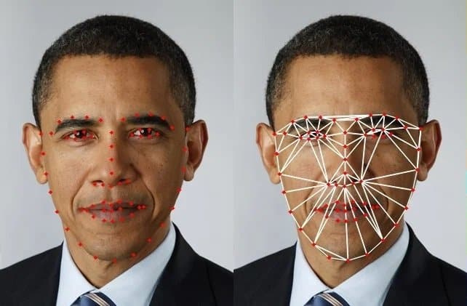
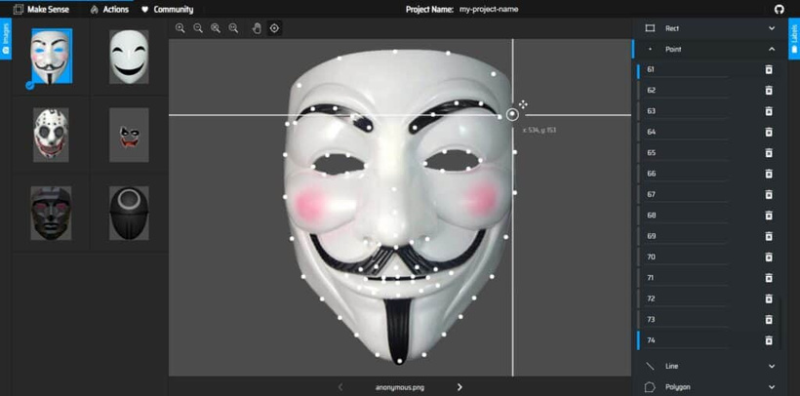
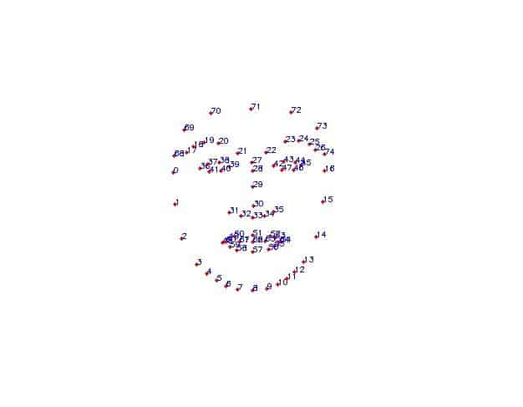
LANDMARK POINTS FROM FACE MESH
Detect 468 Facial Landmarks using Mediapipe Face Mesh
Select the relevant landmarks
Annotate the filters with the selected landmarks
Load annotations
Detect landmark points of the face
Stabilize the landmark points
Transform the Filter on the face using the landmarks
Obama photo - set of landmarks in the left image and the triangulation in the right image.
Annotating filters with points

Slide 9
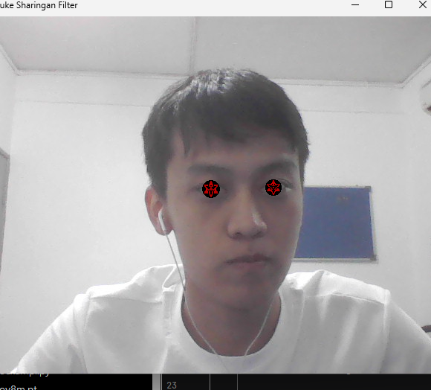
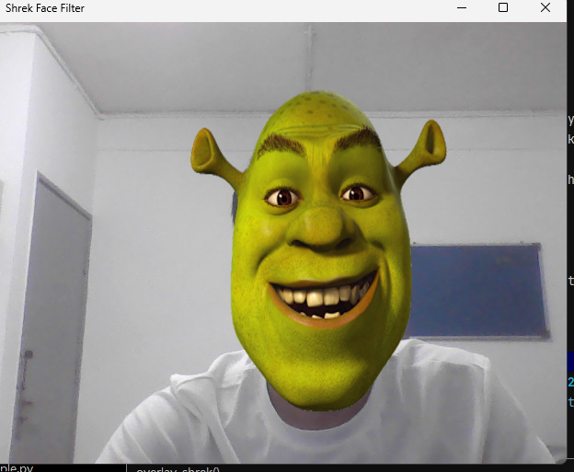
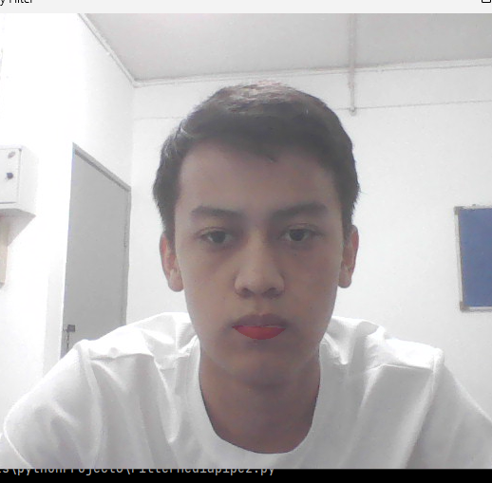
EXAMPLES WITH REAL TIME TRACKING
(Overlaid object) OpenCv
(Mask) Mediapipe
(Beauty filter) Mediapipe
https://github.com/Yerassyl04/CompVision/tree/main/filter10

Slide 10
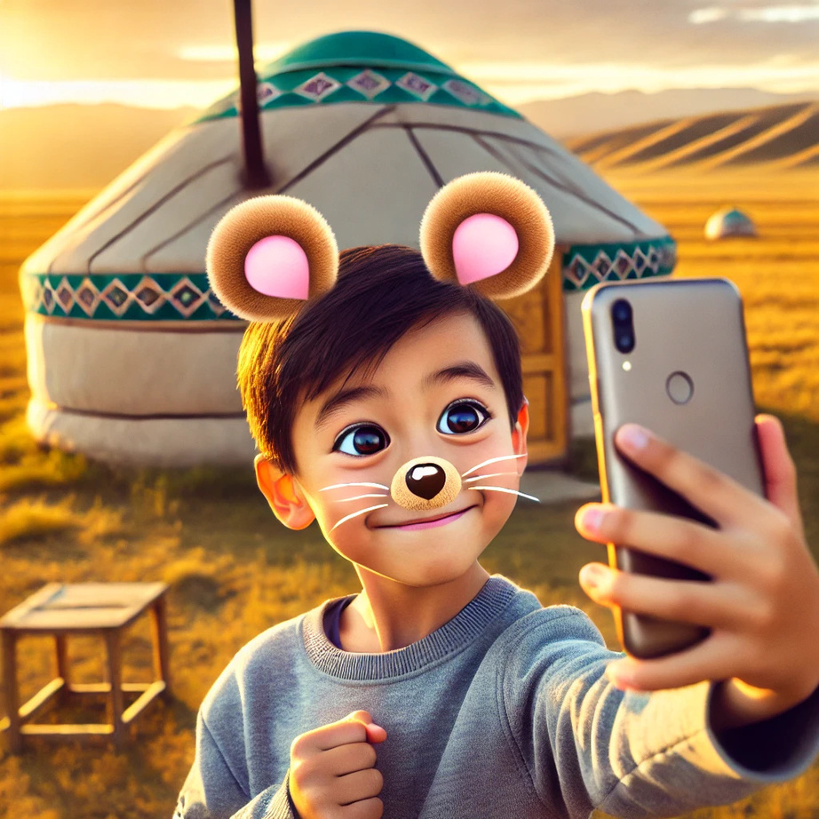
CONCLUSION
Face filters have revolutionized digital communication by providing an innovative way to enhance and transform images. With the integration of advanced technologies like AR and AI, face filters offer a dynamic and engaging experience for users. As they continue to evolve, it’s essential to understand their functionality and impact, ensuring safe and responsible use. By embracing the creative potential of face filters while maintaining awareness of privacy and security, users can enjoy the benefits of these digital effects in a way that enriches their online interactions.

Slide 11
REFERENCES
https://upbent.com/what-are-face-filters-and-how-do-they-work/
https://learnopencv.com/create-snapchat-instagram-filters-using-mediapipe/
https://pub.towardsai.net/how-do-face-filters-work-cea88f470149
https://www.geeksforgeeks.org/face-detection-using-python-and-opencv-with-webcam/

Slide 12
THANKS FOR ATTENTION!

Slide 13
WHAT ?

